Slide 1
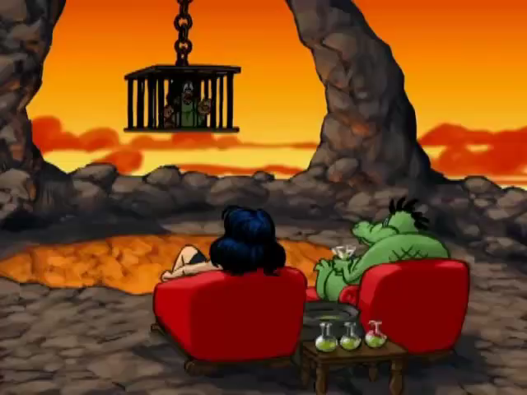
SUB : insert here.
PLAY
SUB : insert here.

Slide 2
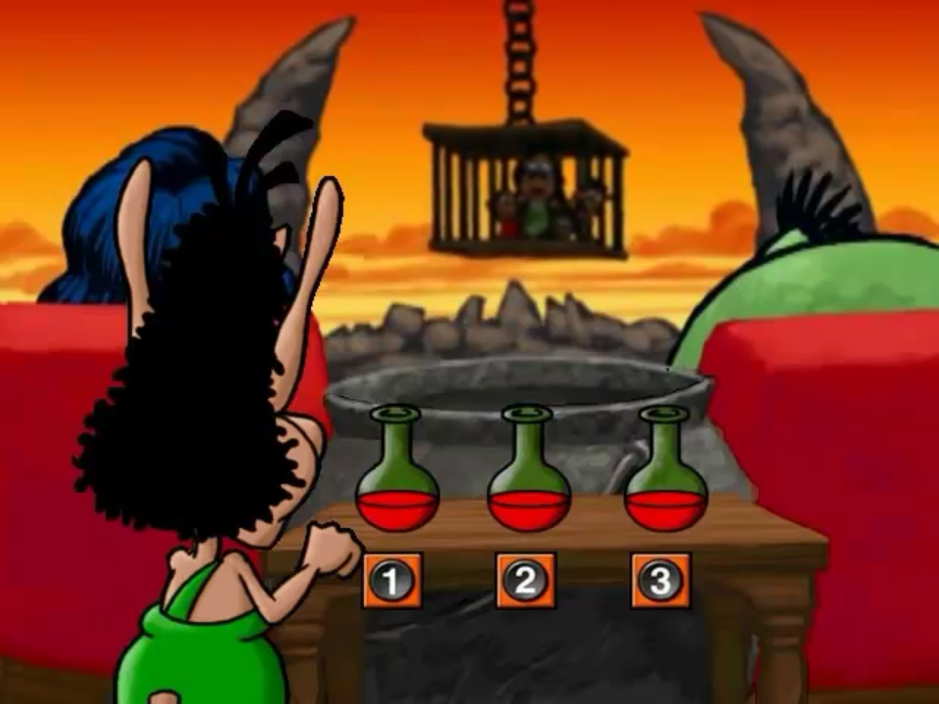
Question 1: insert here.
A. wrong
B. wrong
C. right
NEXT
A
B
C

Slide 3
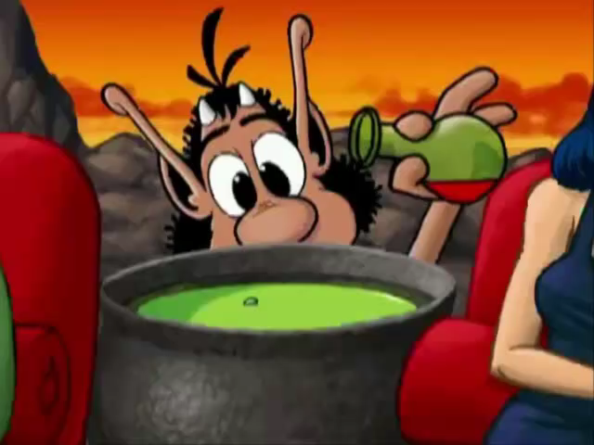
BACK

Slide 4
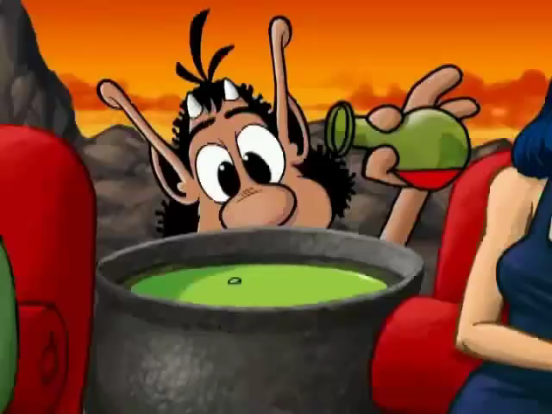
BACK

Slide 5
Question 2: insert here.
A. right
B. wrong
C. wrong
NEXT
A
B
C

Slide 6
BACK

Slide 7
BACK

Slide 8
Question 3: insert here.
A. wrong
B. right
C. wrong
NEXT
A
B
C

Slide 9
BACK

Slide 10
BACK

Slide 11
Question 4: insert here.
A. right
B. wrong
C. wrong
NEXT
A
B
C

Slide 12
BACK

Slide 13
BACK

Slide 14
Question 5: insert here.
A. wrong
B. wrong
C. right
NEXT
A
B
C

Slide 15
BACK

Slide 16
BACK

Slide 17
Question 6: insert here.
A. right
B. wrong
C. wrong
NEXT
A
B
C

Slide 18
BACK

Slide 19
BACK

Slide 20
Question 7: insert here.
A. wrong
B. right
C. wrong
NEXT
A
B
C

Slide 21
BACK

Slide 22
BACK

Slide 23
Question 8: insert here.
A. wrong
B. right
C. wrong
NEXT
A
B
C

Slide 24
BACK

Slide 25
BACK

Slide 26
Question 9: insert here.
A. wrong
B. wrong
C. right
NEXT
A
B
C

Slide 27
BACK

Slide 28
BACK

Slide 29
Question 10: insert here.
A. right
B. wrong
C. wrong
GO HOME
A
B
C

Slide 30
BACK

Slide 31
BACK

Slide 32
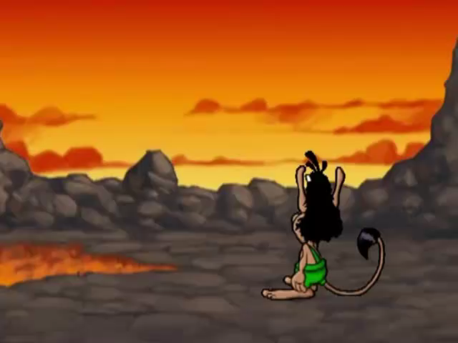
SUB : insert here.
PIPI

